Slide 1

Amazon Electronics Sales Data Analysis and Dashboard (Excel/Power BI)
Aman Jawalekar
Tanisha Singh Rathore
Mohmaad Talha M
Mohammed Aafaq Adeel PS

Slide 2
Problem Statement
Analyze a company’s historical sales data to identify key revenue drivers, seasonal trends, and suggest actionable improvements. Visualize insights through interactive dashboards. Week-wise & Role-wise Task Allocation

Slide 3
Data Collection
This dataset was used in a data science contest by Capgemini. The main concept was to build a product recommendation system.The dataset gives us electronics sales data at Amazon. It contains user ratings for various electronics items sold, along with category of each item and time of sell.
The dataset gives us electronics sales data at Amazon. It contains user ratings for various electronics items sold, along with category of each item and time of sell.
Dataset – https://www.techgig.com/files/contest_upload_files/electronics.csv

Slide 4
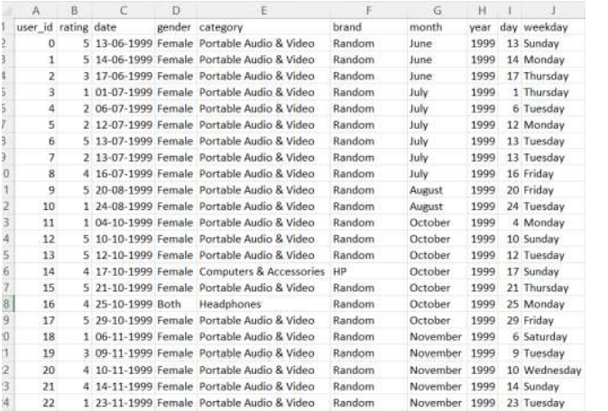
Data Pre-Processing
Handling missing values by dropping rows with missing data.
Dropping unnecessary columns from the dataframe.
Adding new column called Day,Month,Year.
Adding new column weekday.
Created a new Dataset.

Slide 5
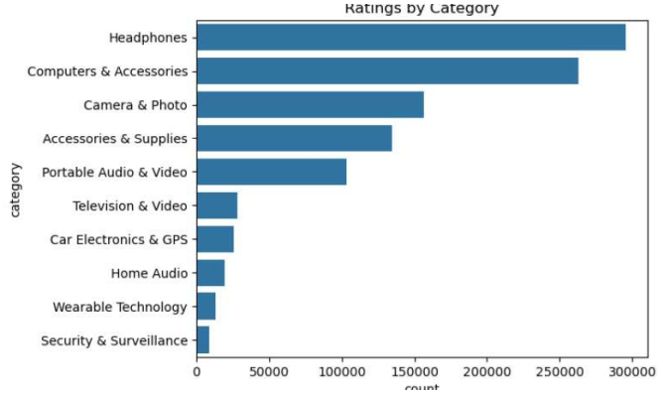
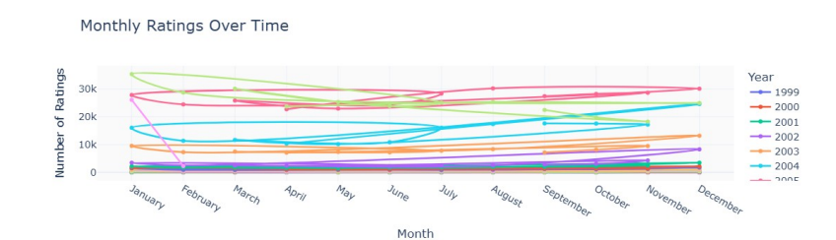
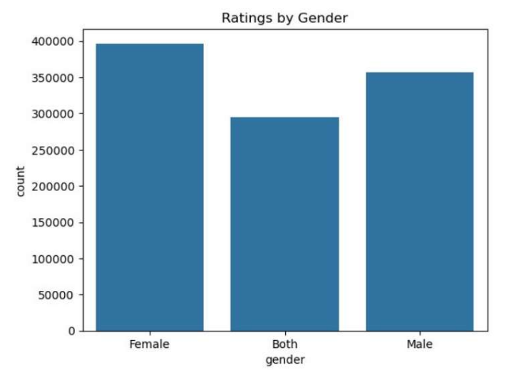
Exploratory Data Analysis

Slide 6
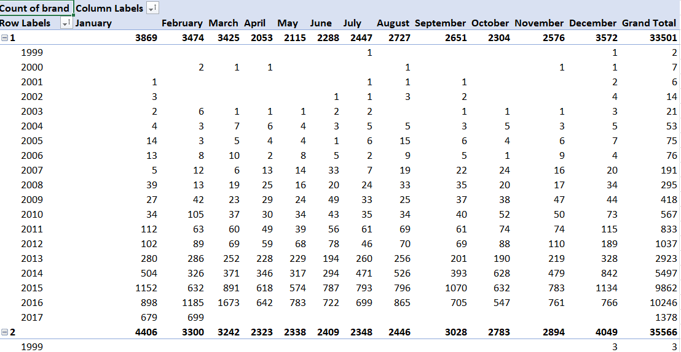
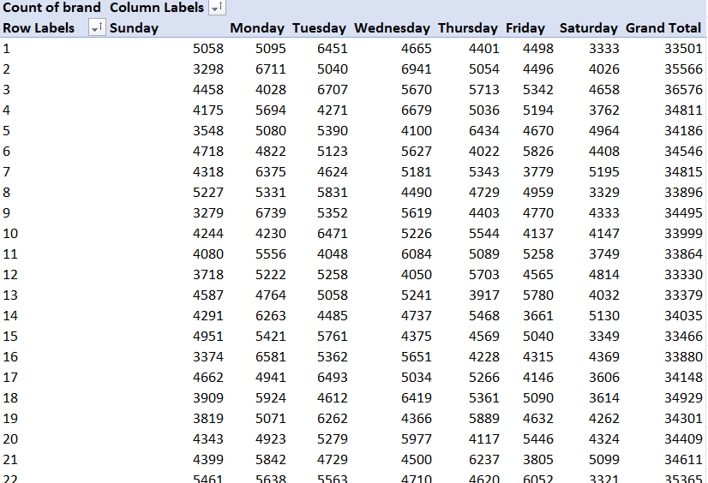
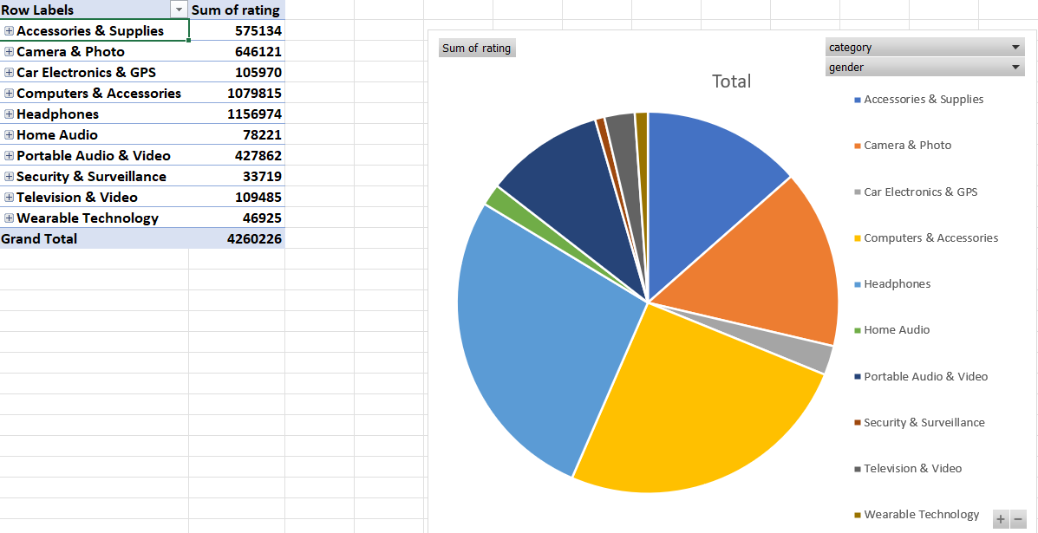
Pivot Table

Slide 7
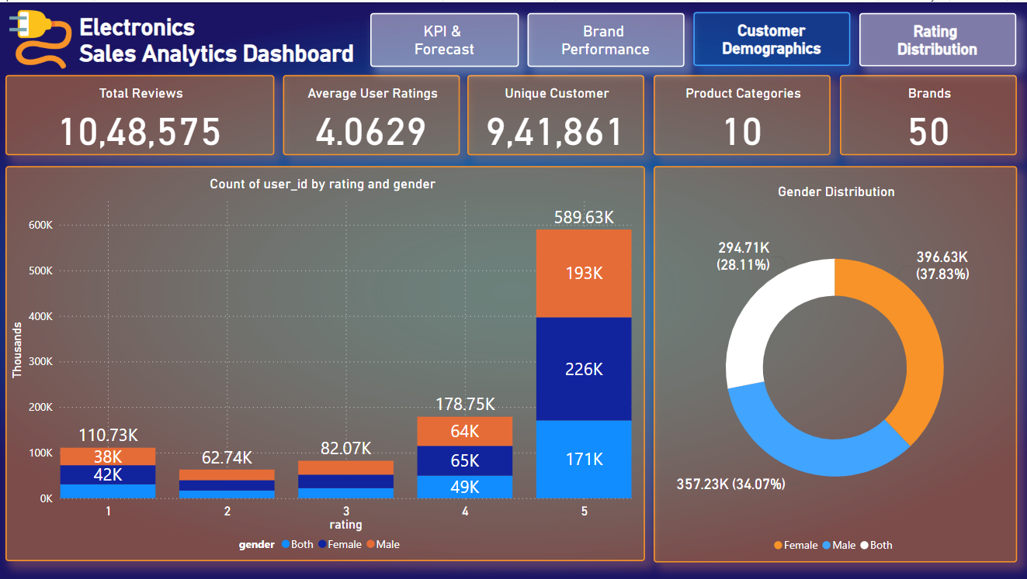
Power BI:
Customer Demographics

Slide 8
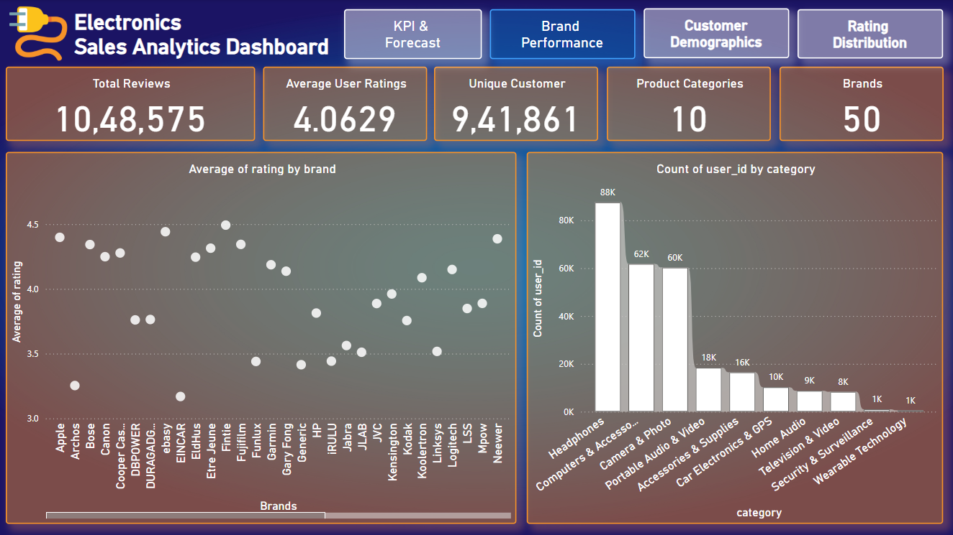
Brand Performance

Slide 9
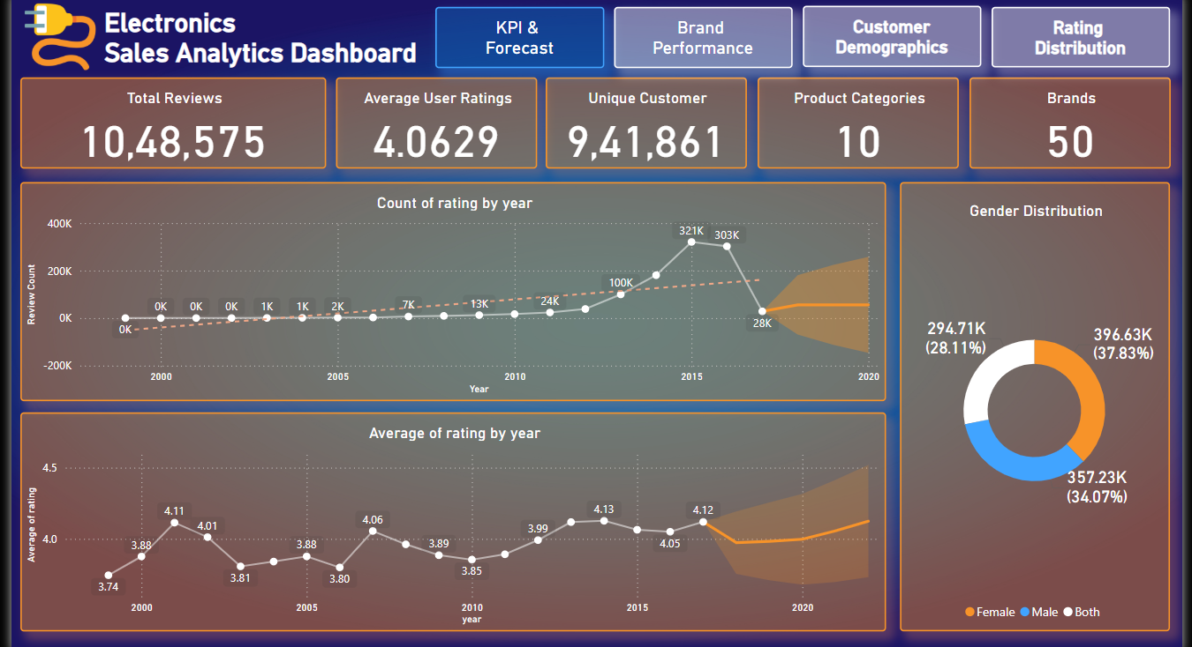
KPI:

Slide 10
Conclusion:
This project successfully dissected over a million records of electronic product sales to uncover patterns, behaviors, and strategic levers hidden in the data. Using a structured approach—data cleaning, exploratory analysis, and interactive visualization—the team transformed raw historical records into actionable business intelligence.
Key findings revealed the dominance of product categories like Headphones, a strong seasonal surge in sales during January and December, and nuanced gender-based preferences in product engagement. However, data inconsistencies such as generic brand labeling (“Random”) limited the full potential of brand-level insights.
The Power BI dashboard and Excel models built during the project enabled interactive exploration of KPIs like total sales, top categories, monthly trends, and customer ratings. These tools not only visualized the data but answered critical business questions—when to sell, what to push, and whom to target.
Furthermore, recommendations for future improvements, from brand data hygiene to targeted campaigns during slow months, offer a roadmap to enhance sales strategy and data quality.
This project bridges data analysis with business impact, proving that with the right lens, even historical data can illuminate future opportunities.

Slide 11
Thank You

